Slide 1

API Scenarios

Slide 2
History lesson

Slide 3
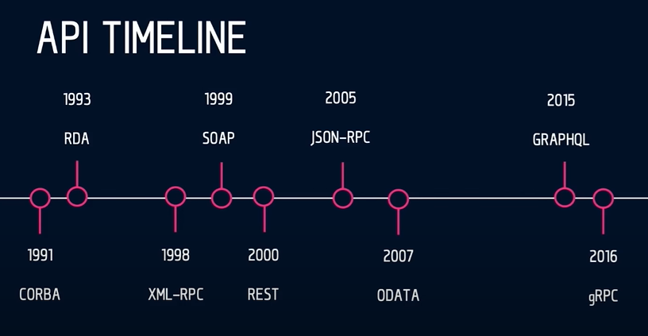
History Lesson

Slide 4
Service-oriented architecture
Messaging protocol for exchanging structured information
Uses XML for communication
Uses various low-level protocols
It is platform and technology agnostic
Pretty much old school

Slide 5
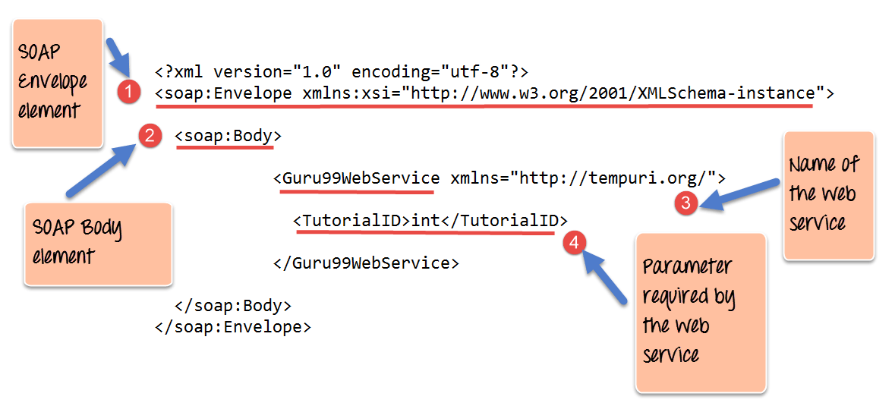
Service-oriented architecture

Slide 6
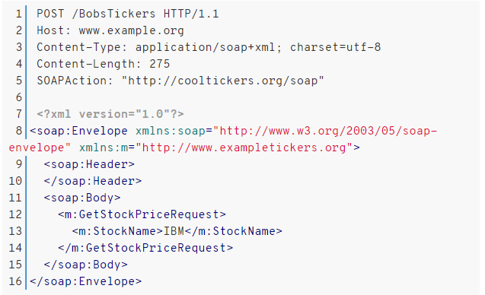
Service-oriented architecture

Slide 7
REST
REST in peace, SOAP
After 2010
Representational State Transfer
The most used API
Developers use the HTTP verbs
GET, POST, PUT, DELETE
On the same URL
Stateless and self-describing

Slide 8
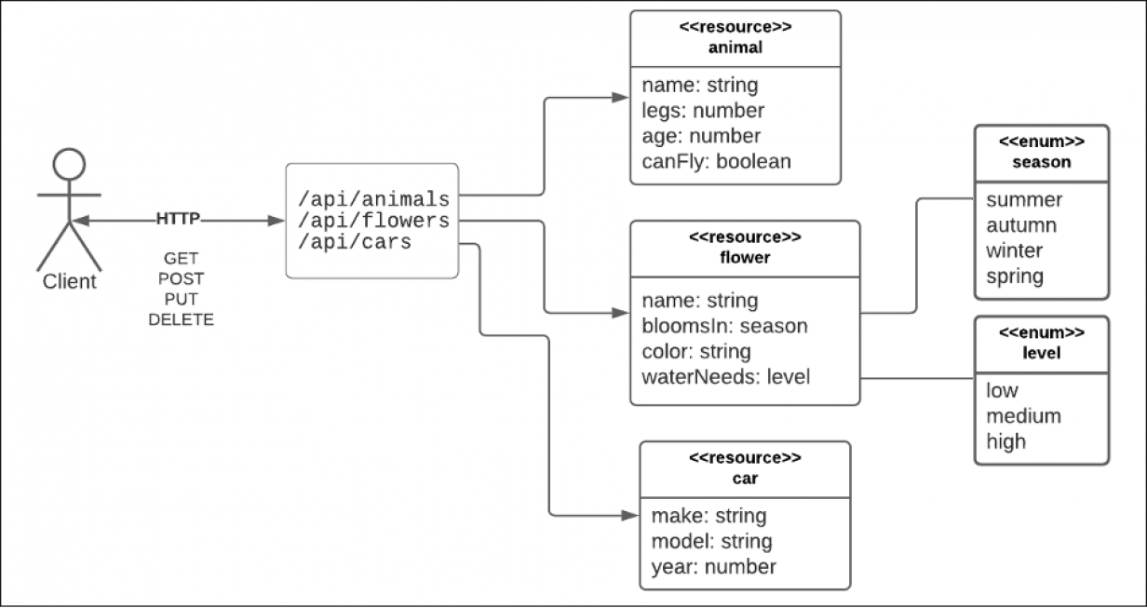
REST

Slide 9
What about now?

Slide 10
GRAPHQL
GraphQL is the new REST? The "next" big thing?
Client-driven
Adaptability
The client decides what data they want
Efficiency
Delivers exactly what the client requests without over fetching
Flexibility
GraphQl is cross-platform
Some say it is a fancy OData

Slide 11
GRAPHQL
You can explore GraphQL with GitHub:
https://docs.github.com/en/graphql/overview/explorer
query {
viewer {
login
repository (name: "MyTested.AspNetCore.Mvc") {
description
labels(first: 20) {
nodes {
name
}
}
}
}
}

Slide 12
GRAPHQL
GraphQL for C#:
https://graphql.github.io/
var schema = Schema.For(@"
type Project {
name: String
}
");
var root = new { Name = "Code It Up" };
var json = await schema.ExecuteAsync(_ =>
{
_.Query = "{ name }";
_.Root = root;
});
Console.WriteLine(json);
{
"data": {
"name": "Code It Up"
}
}

Slide 13
GRPC
The "next next" big thing?
Does not use text format but a binary one
A ".proto" is created for both servers
It is used as definition by which the data is encoded and decoded
Increases performance
Supports bidirectional and asynchronous messages
Based on the HTTP 2 protocol
Each separate element is "streamed" back to the called
Multiple items are not aggregated into a single array

Slide 14
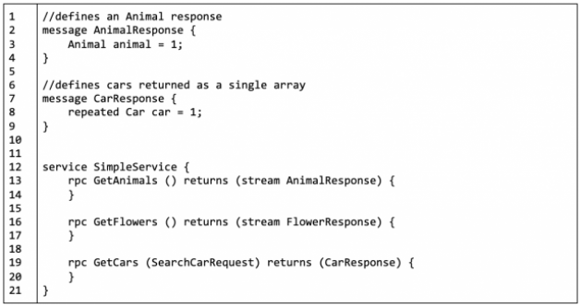
GRPC

Slide 15
API Types

Slide 16
API Types
Query APIs
Flexibility in mind – the client can query data however it wants
Streaming APIs
Real-time data is constantly streamed
RPC APIs
Remote procedural call – components calling each other through distributed networks
Web APIs
The usual HTTP API over the web

Slide 17
Which one of these is the best?
There is no universal best API style
But there is always a best style for YOUR problem
This is the key thing
We need to factor all constraints of the system
To make sure our choice is correct

Slide 18
API Decision Constraints

Slide 19
Business constraints
Customer constraints
Business constraints
Product requirements
Performance or scalability constraints
If the customer expects REST, you will not be able to use RPC

Slide 20
Technology constraints
The team's knowledge
Distributed systems and their fallacies:
The network is reliable
Latency is zero
Bandwidth is infinite
The network is secure
Topology doesn't change
There is one administrator
Transport cost is zero
The network is homogeneous
https://dzone.com/articles/understanding-the-8-fallacies-of-distributed-syste

Slide 21
General advice

Slide 22
General Advice
If an API is mostly CRUD and manipulation of related data
Use REST
Example URL: /purchases/2/items
If an API is mostly actions or between servers
Then choose RPC
Example URL: /purchases/increment
Do not build REST-ish APIs
If you cannot simply follow the REST pattern
Choose GraphQL

Slide 23
Various Issues to consider
SOAP is legacy
You should not consider it most of the time
Only when it is already implemented
REST may be slow
Over/under fetching with REST
N + 1 problem
GraphQL allows to fetch all data with one request

Slide 24
Various Issues to consider
The slowest field is the performance indicator
In GraphQL you fetch data all at once
GraphQL is more flexible, if you do not know the client
But way more restrictive than REST

Slide 25
Versioning
GraphQL allows better versioning than REST
Allows "deprecations"
But where it is possible use graceful evolution
Graceful evolution:
Do not add required inputs
Do not remove outputs or make them optional
Do not change the type of a field

Slide 26
Contract first design

Slide 27
First create the contract
In GraphQL you have the schema
In gRPC you have the protocol buffer file
In REST you have Open API (Swagger)
Having a contract helps you mock the API during development
Integration is easier between the back-end and front-end

Slide 28
API Styles comparison

Slide 29
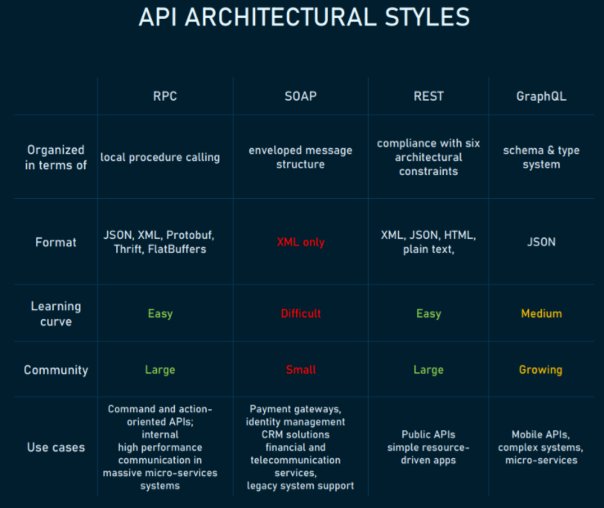
Styles Comparison

Slide 30
SOAP
Pros:
Language- and platform-agnostic
Bound to a variety of transport protocols
Built-in error handling
Several security extensions
Cons:
XML only
Heavyweight
Narrowly specialized knowledge
Tedious message updating
Use cases:
Highly secured data transmission

Slide 31
REST
Pros:
Decoupled client and server
Discoverability
Cache-friendly
Multiple formats support
Cons:
No single REST structure
Big payloads
Over-and under-fetching problems
Use cases:
Management APIs
Simple resource-driven apps

Slide 32
GraphQL
Pros:
Typed schema
Fits graph-like data very well
No versioning
Detailed error messages
Flexible permissions
Cons:
Performance issues
Caching complexity
A lot of pre-development education
Use cases:
Complex systems and microservices

Slide 33
RPC
Pros:
Straightforward and simple interaction
Easy-to-add functions
High performance
Cons:
Tight coupling to the underlying system
Low discoverability
Function explosion
Use cases:
Customer-specific APIs for internal microservices

Slide 34
Sample scenarios

Slide 35
Application web form
For example, buying an airplane ticket online
CRUD
Single client that uses all fields
This use case is well-suited for REST
Everything else is overcomplicated
Real-life example:
PayPal

Slide 36
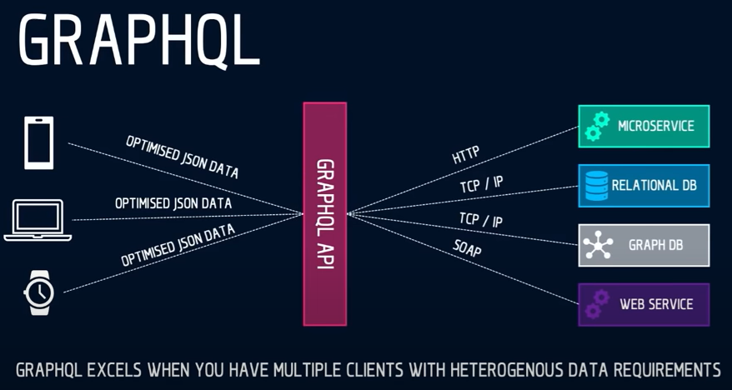
Composite API
For example, fetching prices from multiple stores
Aggregate data from various sources
Have one convenient API
Use GraphQL – it shines for these scenarios
Real-life example:
GitHub

Slide 37
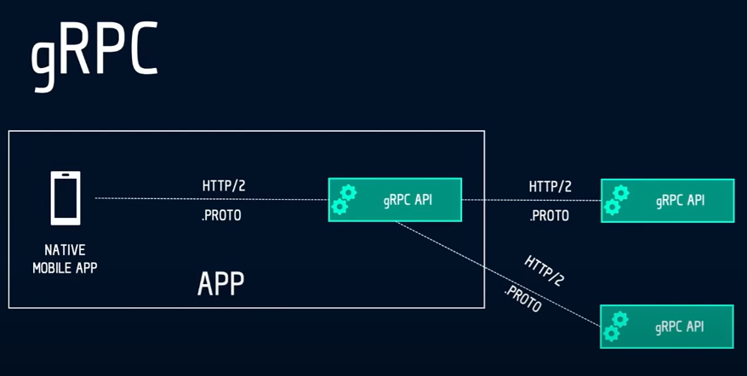
Native mobile
For example, stock market charts
We need a "back-end for front-end"
Single client
Static API
The use case is well suited for gRPC
Real-life example:
Foursquare

Slide 38
Polyglot microservices
For example, Amazon store front
Polyglot environment
Internal communication is required
Both asynchronous and with a response
gRPC is perfect for this scenario
Real-life example:
Google Cloud

Slide 39
ANY QUESTIONS?

